Slide 2
Who are SIFA Fireside
SIFA Fireside are a charity that supports people who are homeless in Birmingham, helping them to lead healthier and happier lives.
SIFA Fireside’s Aims:
Jobs
Skills
Health
Friendship
Notes:
SIFA Fireside is a charity based in Birmingham that supports people who are homeless and vulnerable in our city. They see up to 100 clients at their Drop In centre each day.
SIFA Fireside aim to:
Reduce the number of people who are homeless in the city
Increase life skills
Help people get jobs
Improve people’s health
Offer a listening ear and make people feel less alone

Slide 3
What does it mean to be homeless?
If someone is sleeping or living…
On the streets
In a hostel
In empty buildings
In friends or family’s homes
In a car
An estimated 1 in 96 people are currently classed as homeless in Birmingham
In temporary accommodation
Notes:
In 2021 it is estimated that 274,000 people are homeless in the UK – 1 in 200 people
It is estimated that 1 in 96 people are homeless in Birmingham.
One of the most visible types of homelessness in our city, the term ‘rough sleeper’ refers to somebody who is homeless and sleeping in the open air, on the streets, in doorways or parks, public spaces.
The difference between rough sleeping and homelessness is that it is possible to be homeless, but not be rough sleeping. Somebody may be classed as homeless if they are…
Living in a hostel
Living in empty buildings
Sleeping in friends or family's houses / sofa surfing
Sleeping in a car
Living in temporary accommodation

Slide 4
How do people become homeless?
Factors that can lead to somebody experiencing homelessness…
Losing their job
Being treated unfairly
Mental and physical illness
Being forced to leave their home
Not having family and friends to help out
Notes:
Somebody may become homeless because they do not have the options or opportunities available to them that we sometimes take for granted.
Losing their job: one in three people in the UK could not pay for their home for more than a month if they lost their job.
Being treated unfairly: because of skin colour, gender, sexuality or religion, or anything else that might make somebody ‘different’.
Mental and physical illness
Being forced to leave their home
Not having family and friends to help out

Slide 5
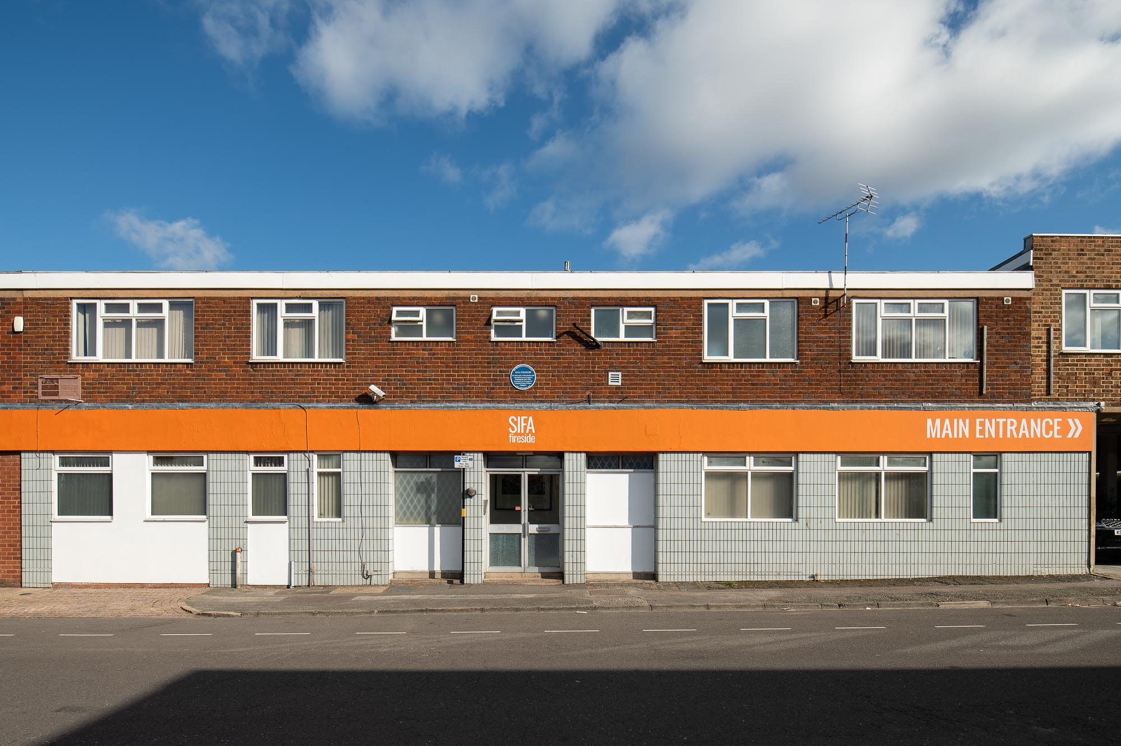
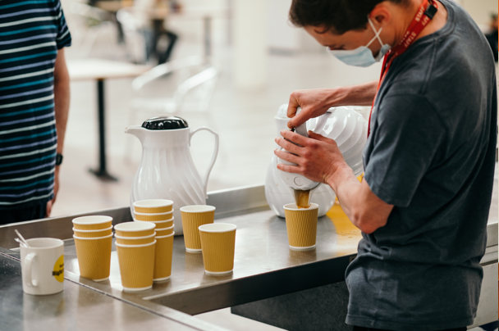
Notes:
SIFA Fireside helps people who are struggling in Birmingham to lead happier and healthier lives.
And they welcome four-legged friends too! Dogs, cats, even tortoises…

Slide 6
What do SIFA Fireside do to help?
prevention
recovery
SIFA Fireside support people who are struggling to stay in their home, and help to stop them from becoming homeless.
SIFA Fireside stand by their clients as they move on from homelessness.
crisis support
Their Drop In centre is open Monday to Friday from 9am to 12:45pm, providing a safe space for their clients

Slide 7
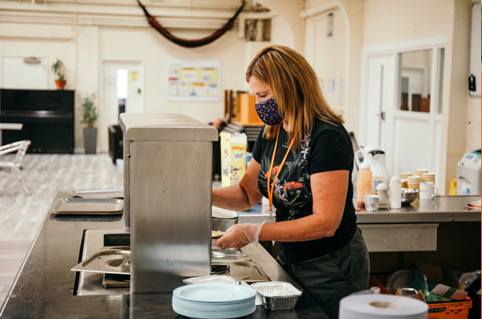
SIFA Fireside: What They Do
SIFA Fireside help up to 100 people who are homeless or in crisis at their Drop In each day.
Drop In Services:
Clothing
Laundry
Showers
Hot drinks
Breakfast and lunch
Sleeping bags
Safe storage
Postal address
Emergency housing
Weekly nurse visits
Barber
Street vet
Food parcels
Toiletries
Notes:
SIFA Fireside see up to 100 clients at their Drop In centre each day. The Drop In is open Monday to Friday from 9am to 12:45pm, providing a safe and supportive environment for homeless and vulnerable people in our city.
They offer immediate practical help for anyone who is sleeping rough or in crisis, including emergency housing, hot food and drinks, showers, laundry, new clothing, food parcels and sleeping bags.
They also have a barber, a weekly nurse clinic, and a street vet who comes in to look after our clients’ pets.

Slide 8
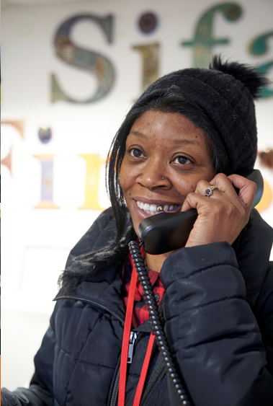
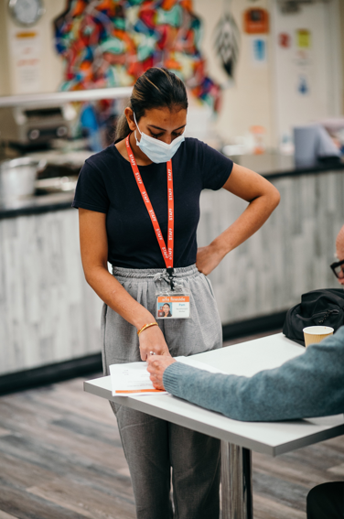
SIFA Fireside: What They Do
Recovery and Prevention
Cookery
Photography
Art classes
Client forum – a bit like school council!
Workshops to help with money
Job club
English lessons
Music, drama… even Opera!
Notes:
SIFA Fireside allow people who have experienced or are at risk of homelessness to get their lives back on track.
What they do…
Cookery
Photography
Art classes
Client forum – a bit like school council!
Workshops to help with money
Job club
English lessons
Music, drama… even Opera!

Slide 9
The answer to homelessness?
Its not just 1 thing…
choices
food
friendship
internet
warmth
creativity
job opportunities
money
relationships
workshops
safety
showers
community
compassion
support
doctors
protection
sleeping bag
training
Notes:
There are many factors that contribute to getting somebody back on track after experiencing homelessness.
Being homeless doesn’t just mean not having a roof over your head – there are many other things that people need to lead healthy, happy lives.
That’s why SIFA Fireside aim to provide all of these things and more under one roof.

Slide 10
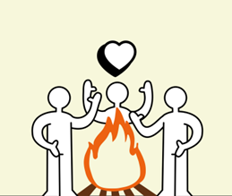
How can you help?
Raise money for a local charity
Offer donation collections
Be kind and compassionate
Can you think of any more ideas?...
Notes:
How can you help?
Offer to organise a donation collection for a local charity.
Help a local charity by raising money at school:
Sponsored silence
Challenge yourself
Camp out in your garden to support people who are homeless
Take a look at SIFA Fireside’s fundraising pack.
And the most important thing is to be kind and compassionate and care about others.
Can you think of more ways you could help people who are homeless in Birmingham?

