Slide 2
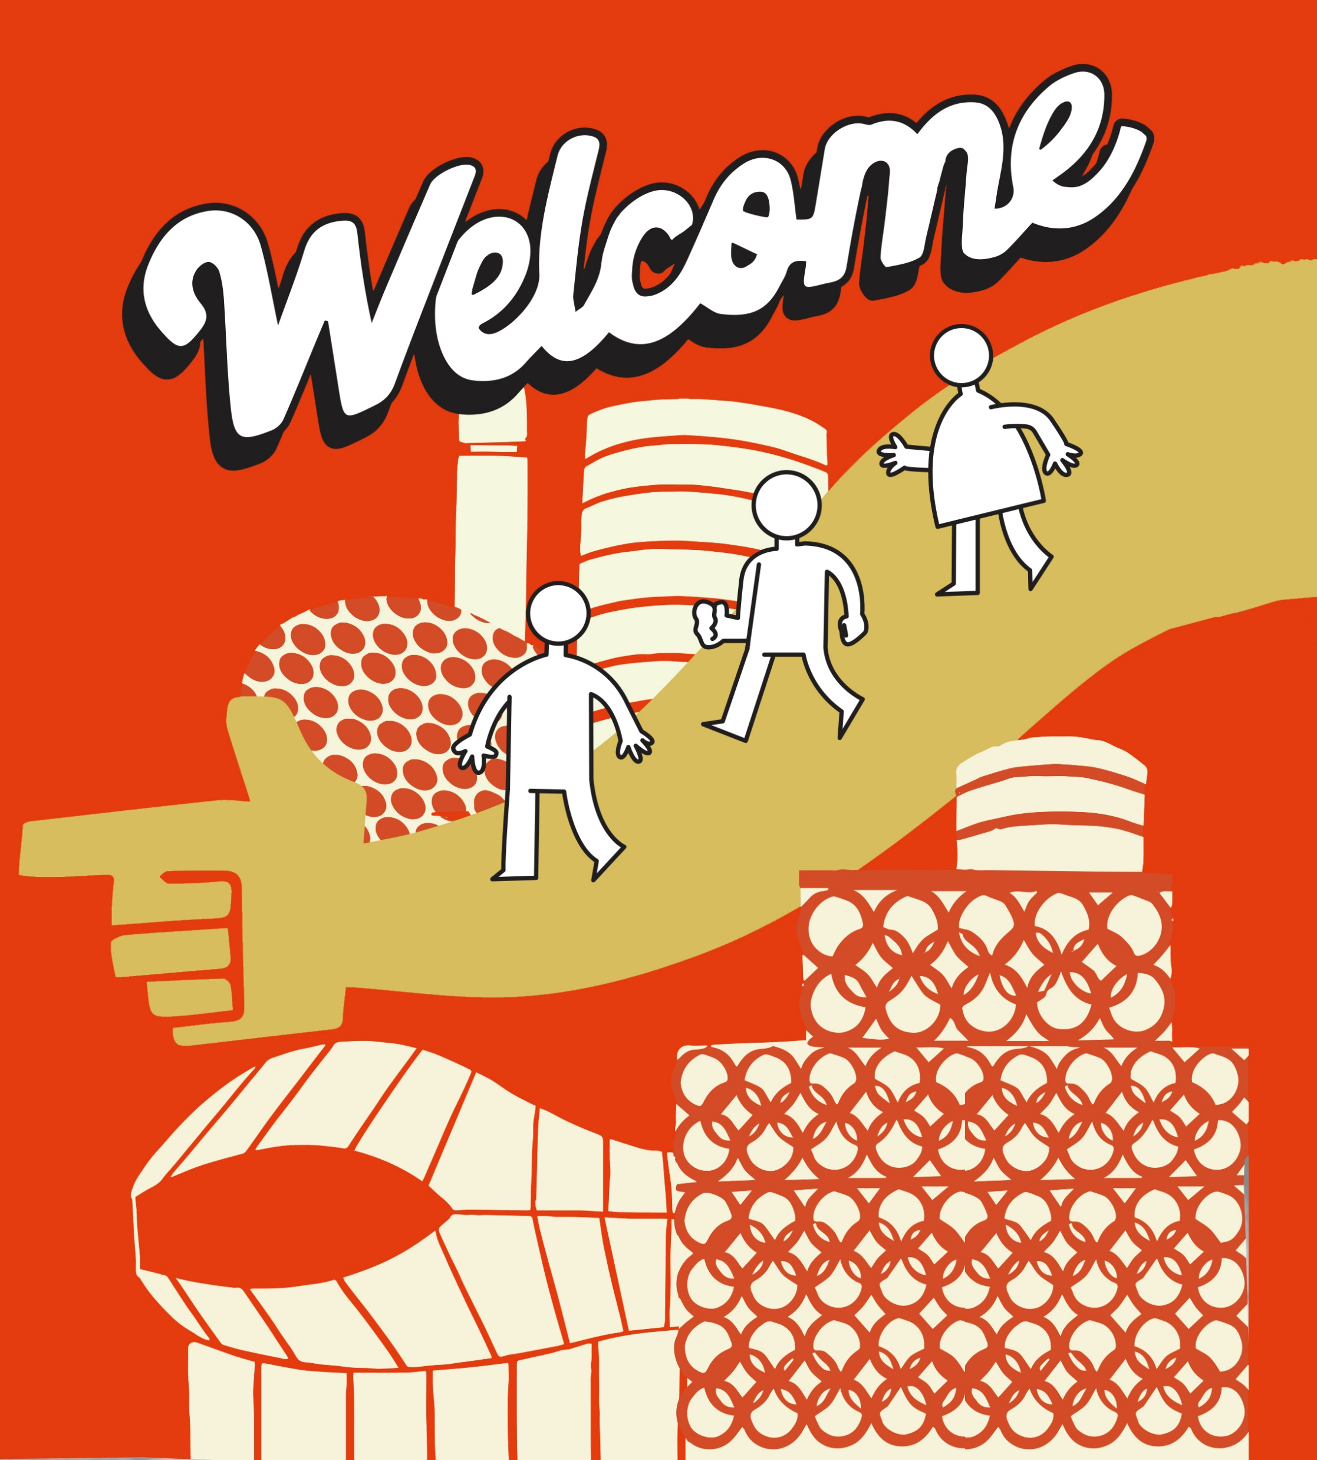
Who are SIFA Fireside
SIFA Fireside are a charity organization that supports Birmingham’s homeless and vulnerably housed adults in leading healthier and happier lives.
SIFA Fireside’s Aims:
Reduce homelessness
Increase social inclusion
Increase life skills
Improve health
Improve employment potential
Reduce offending
Notes:
SIFA Fireside is a charity based in Birmingham that supports people who are homeless and vulnerable in the city. They see up to 100 clients at their Drop In centre each day.
SIFA Fireside aim to work with their clients to achieve the following things:
Reduce homelessness
Increase social inclusion
Increase life skills
Improve health
Improve employment potential
Reduce offending

Slide 3
What does it mean to be homeless?
If someone is living…
On the streets
In a hostel
In empty buildings
Sleeping in friends or families houses
Sleeping in a car
In temporary accommodation
An estimated 1 in 96 people are currently classed as homeless in Birmingham
Notes:
In 2021 it is estimated that 274,000 people are homeless in the UK – 1 in 200 people
It is estimated that 1 in 96 people are homeless in Birmingham – twice the national average.
One of the most visible types of homelessness in our city, the term ‘rough sleeper’ refers to somebody who is homeless and sleeping or bedding down in the open air, on the streets, in doorways or parks, public spaces. People who are Rough Sleeping are highly vulnerable to physical and mental health issues, exploitation, violence and abuse
The difference between rough sleeping and homelessness is that it is possible to be homeless, but not be rough sleeping. Somebody may be classed as homeless if they are…
Living in a hostel
Living in empty buildings
Sleeping in friends or family's houses / sofa surfing
Sleeping in a car
Living in temporary accommodation
Local authorities have a duty to secure a home for some groups of people. To be legally defined as homeless you must either lack a secure place in which you are entitled to live or not reasonably be able to stay.
Somebody who has no recourse to public funds, or who does not have any current immigration permission, will not be eligible for homelessness assistance or a housing allocation, meaning they often have no choice but to sleep rough.

Slide 4
How do people become homeless?
Factors that can lead to homelessness…
Unemployment
Discrimination
Mental and physical health conditions
Eviction
Relationship breakdown
Lack of support networks
Immigration status
Notes:
Unemployment
As unemployment rates increase as a result of the pandemic, organisations like SIFA Fireside have seen more people in need of support services for the first time in their lives.
Research undertaken by Shelter reveals that more than 8 Million people are one pay day away from not being able to pay their mortgages or rent. One in three workers could not pay for their home for more than a month if they lost their job.
Discrimination
5.4% of the UK population identify as LGBTQ+, whereas 24% of people who are homeless in the UK identify as LGBTQ+. Over 4 times the national average.
12.8% of people living in the UK are from an ethnic minority group, whereas 38% of people who are homeless are from an ethnic minority group.
Mental and physical health conditions
Other factors that can lead to homelessness:
Eviction
Relationship breakdown
Lack of support networks
Immigration status
Somebody may become homeless because they do not have the options or opportunities available to them that we sometimes take for granted.

Slide 5
Homelessness is not a choice for people.
Mortality rates
Health conditions
Violence
Addictions
Stigma
42-44 years
41%
63%
25%
Notes:
A common misconception about people experiencing homelessness is that they choose to be homeless. The following statistics indicate why this is not the case.
1. Mortality rates
People who experience rough sleeping over a long period, on average, face a higher likelihood of dying prematurely compared to the general population.
The average age at death of people who experience homelessness is 44 years for men compared to 76 years in the general population.
For women experiencing homelessness. The average age of death is 42 years compared to 81 years for women in the general population.
2. Health conditions
The number of A&E visits and hospital admissions per homeless person is four times higher than for the general public.
An estimated 41 per cent of people experiencing rough sleeping have long-term physical health problems such as heart disease or diabetes, compared to 28 per cent of the general population.
Physical health conditions associated with rough sleeping:
Skin and foot problems
Poor Sleep Patterns
Poor diet leading to poor nutrition
Poor dental hygiene
Respiratory illness
Skin conditions
According to research by Homeless Link, 80% of people experiencing homelessness reported some form of mental health issue.
3. Violence
Many homeless people are at risk of being beaten up or mugged especially while out on the streets at night.
Some people become homeless after fleeing an abusive household. 63% of homeless women have experienced domestic abuse in their lifetime.
4. Addictions
The NFA team in Leeds conducted a study as follows: “A random sample of homeless patients were questioned regarding drug use. Of those taking drugs, 75% stated that their drug use was the cause of them becoming homeless, while 25% stated that being homeless caused them to take drugs”
5. Stigma and misconceptions
Examples of misconceptions faced by people experiencing homelessness:
Everybody that is homeless drinks or takes drugs.
They deserve to be homeless.
They are bad people.
They are criminals.
They smell and they are dirty.
They choose to be homeless.

Slide 6
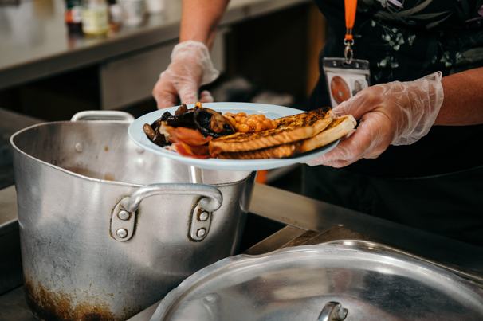
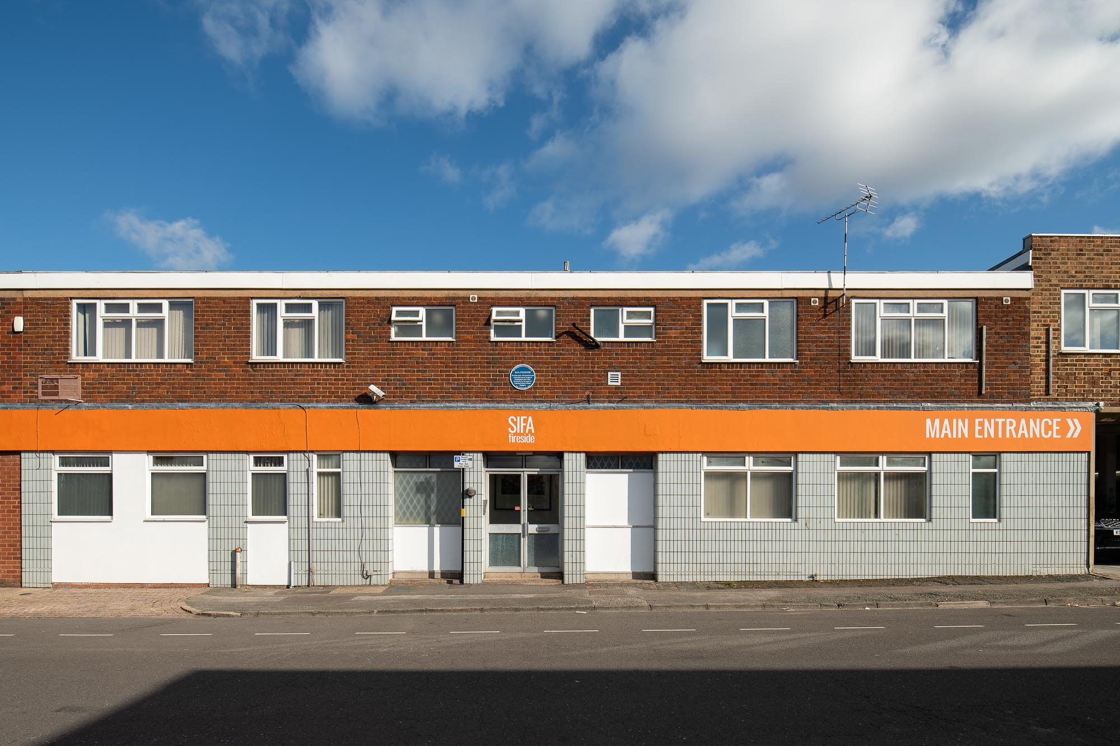
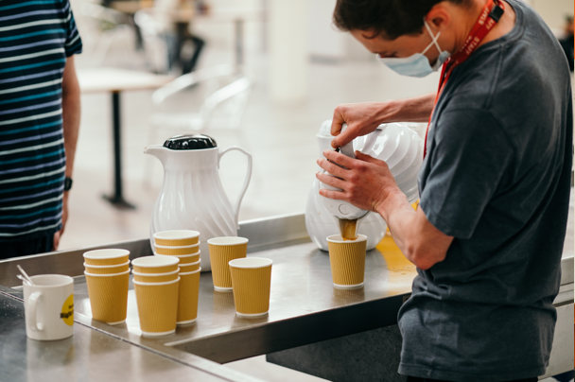
Anybody can become unhappy, depressed, addicted, homeless, destitute and at-risk.
SIFA Fireside’s services are here to stand by the people of Birmingham while they rebuild their lives with safety and dignity.
Notes:
SIFA Fireside provides a wide range of services at their centre so that individuals can access all the support they need under one roof.
And they welcome four-legged friends too! Dogs, cats, even tortoises…

Slide 7
What do SIFA Fireside do to help?
prevention
recovery
The charity protect people at risk of homelessness before the point of crisis.
SIFA Fireside stand by their clients as they rebuild their lives with safety and dignity.
crisis support
Their Drop In is open Monday to Friday from 9am to 12:45pm, providing a safe and supportive environment for clients to access their services.
Notes:
SIFA Fireside offers 3 main branches of support.

Slide 8
Prevention: the Adult Support Hub
The Adult Support Hub (ASH) strives for early intervention and homelessness prevention for single adults and childless couples aged over 25 in Birmingham.
This includes:
Money and welfare benefits advice
Health and wellbeing services
Housing guidance
Maintaining employment
Notes:
The Adult Support Hub (ASH) strives for early intervention and homelessness prevention for single adults and childless couples aged over 25 in Birmingham. Funded by Birmingham City Council, ASH provides tailor-made services for each individual’s set of unique circumstances.
This can range from offering money and welfare benefits advice, health and wellbeing services and guidance with regards to specialist housing.
Maintaining employment is, of course, an integral part of preventing homelessness which is why SIFA Fireside hosts Job Clubs and CV workshops, English Language sessions and regularly signposts clients to employability training and budgeting workshops.

Slide 9
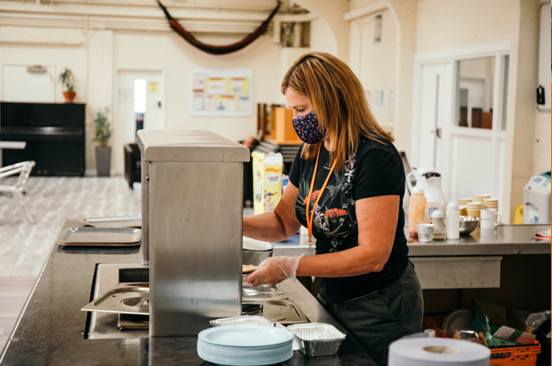
Crisis support
SIFA Fireside help up to 100 people who are homeless or in crisis at their Drop In each day.
Drop In Services:
Clothing
Laundry
Showers
Hot Drinks
Breakfast and Lunch
Sleeping bags
Safe document storage
C/O address
Emergency accommodation
Weekly nurse clinic
Barber
Signposting
Food parcels
Toiletries
Notes:
SIFA Fireside see up to 100 clients at their Drop In centre each day. The Drop In is open Monday to Friday from 9am to 12:45pm, providing a safe and supportive environment for homeless and vulnerable people to access their services.
They offer immediate practical help for anyone who is sleeping rough or in crisis, including emergency housing support, hot food and drinks, showers, laundry, new clothing, food parcels and sleeping bags.
They also have a barber, a weekly nurse clinic, and on site mental health services.

Slide 10
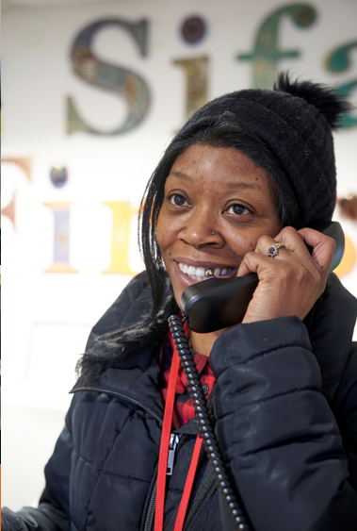
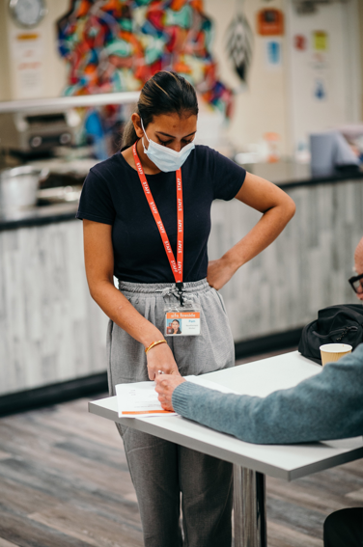
Recovery
SIFA Fireside stand by their clients as they rebuild their lives with safety and dignity.
Activities & Life Skills
Community Engagement
Client Forum
Financial Inclusion & Benefit Advice
Housing Support
Employability
Modern Slavery Support
Immigration
Homeless Transition Workers
Notes:
SIFA Fireside provide recovery services to enable their clients to rebuild their lives with safety and dignity.
These include:
Activities & Life Skills
Expressing themselves, learning new skills, connecting with others
Cookery class
Photography project
Music, drama and art
Community Engagement
Client Forum
Financial Inclusion & Benefit Advice
Housing Support
Employability
Modern Slavery Support
Immigration
Homeless Transition Workers

Slide 11
The answer to homelessness?
Its not just 1 thing…
choices
food
inclusion
access to technology
self expression
relationships
financial support
job opportunities
workshops
warmth
showers
community
compassion
referrals
health clinics
protection
sleeping bag
training
Notes:
There are many factors that contribute to getting somebody back on track after experiencing homelessness.
Being homeless doesn’t just mean not having a roof over your head – there are many other things that people need to lead healthy, fulfilling lives.
That’s why SIFA Fireside aim to provide all of these things and more under one roof.

Slide 12
How can you help?
Research local services and food banks
Offer donation collections
Help a local charity by raising money at school
Streetlink
Educate yourself
Be kind and compassionate
Notes:
How can you help?
Research local services and foodbanks - find out what your local provisions are so that you can spread the word, and inform people who may need support.
Offer to organise a donation collection for a local charity.
Help a local charity by raising money at school:
Sponsored silence
Challenge
Camp out in your garden to support people who are homeless
Take a look at SIFA Fireside’s fundraising pack.
Streetlink is a great way to notify local services that someone is sleeping rough and help them to access the support they need. They have a website and an app.
Educate yourself – here are some national charities where you can find out more… Shelter and Crisis
And the most important thing is to be kind and compassionate and care about others.

